Slide 1


Breaking Down Your
Website Quality Assessment
PREPARED FOR
AVA
May 2025

Slide 2


What’s in this document?
1
What “website quality” is and why it’s important.
2
What inputs go into the report and how we analyze them.
The outputs of the report and how we use them to execute your campaign.
3

Slide 3
What is “Website Quality”?
Search engines send traffic to websites they deem as “high quality”. That means a few things:
Sites that are coded and structured according to their webmaster guidelines.
Sites that are “popular”, i.e. getting mentioned across the web.
Sites that satisfy “searcher intent” through relevant and quality content.
Having low quality pages, content, poor structure and lack of web mentions causes Google to lose trust in your website and crawl, index and rank it less and less over time.
We assess quality of your website by looking at a number of different data inputs, including inbound links, titles, content depth, sales from organic traffic, keyword rankings and more.
Additional resources:
Google’s Quality Score (Moz)

Slide 4

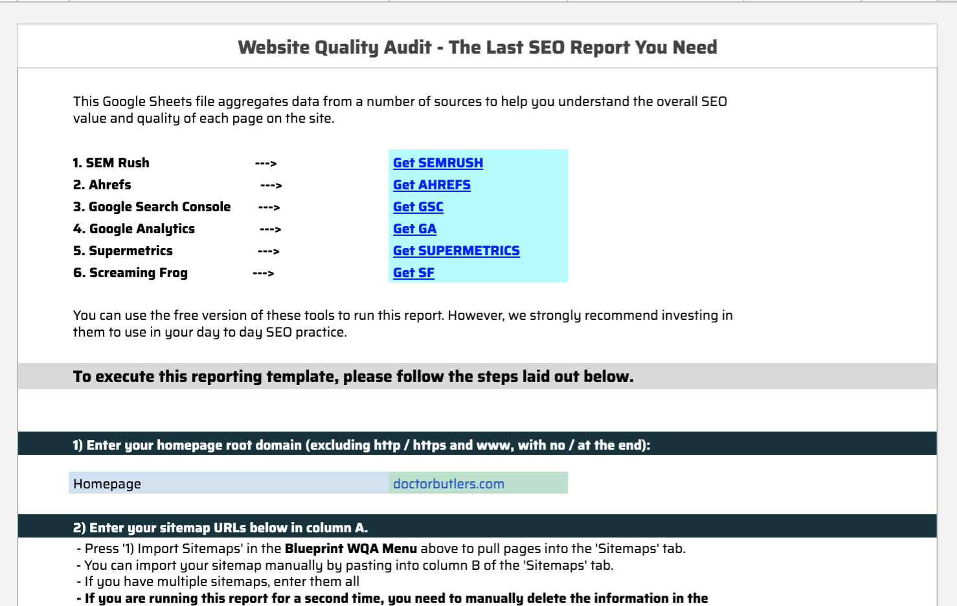
What goes into the “WQA”?
Our team built a tool using API data from 5 vital SEO data sources:
XML sitemaps - to get a list of URLs included in your Sitemap.
Screaming Frog - to get a full list of URLs and files uploaded to your site, page titles, metas, canonical tags and word count per page.
Ahrefs (Backlinks) - to get a list of the links pointing to your website and which pages they point to.
Ahrefs (Keywords) - to get your current keyword rankings and which pages they correlate to.
Google Analytics - to get sales, leads, and traffic data from search engines only.
Google Search Console - to get SERP impressions and page level click through rates in Google.
Our tool aggregates this data and allows us to assess quality metrics at the page level. From here, we can make a decision about what to do with every page on your site.

Slide 5

Tours, Activities & Attractions
What comes out of the “WQA” - Site Sections
Category Tag | Detail
Home Page | Primary landing page showcasing tour offerings, main navigation, and featured experiences.
Tour Page | Dedicated page for individual tours or activities, detailing itineraries, price, and booking.
Tour Category - Location | Listing of tours and activities grouped by geographical locations (city, state, country).
Tour Category - Activity | Grouped listings based on activity type (adventure, cultural, culinary, etc.).
Tour Category - Destination | Listing tours grouped by broader destination or attraction (e.g., Eiffel Tower, Grand Canyon).
Blog Post | Individual blog articles typically providing travel tips, guides, or experiences.
Blog Category | Sections grouping blog posts by themes or topics for better navigation.
Country Travel Guide | In-depth guide covering key travel info, top experiences, accommodations, and tips per country.
State Travel Guide | Guide specific to individual states or regions within a country.
City Travel Guide | Detailed guides dedicated to specific cities, including attractions, dining, accommodation.
Landmark/Attraction Guide | Dedicated informational page on notable landmarks or attractions.
Site Info | Required informational pages (e.g., Contact Us, FAQs, Terms & Conditions).
Author Page | Page dedicated to authors/bloggers highlighting their profile and posts they've written.
Media Gallery | Collection of photos/videos highlighting tours, activities, or attractions.
After the data is pulled and aggregated, the manual process begins. The first thing we do is group each page into a “section” (see chart for all the section categories we use). We do this for two reasons:
It allows us to segment the site and better prioritize pages / keywords to focus on.
It allows us to compare “apples to apples” (i.e. we don’t want to be comparing an FAQ page to a product page).
Notes:
Tours, Activities & Attractions

Slide 6
What comes out of the “WQA” - URL Actions
URL Action | Detail
1. Leave As Is | No action needed on the page. You can use this tag for pages performing well or for pages you simply want to ignore because they are irrelevant to your SEO (contact page, etc).
2. Update "On Page" | Use this when you want to review the keywords, titles, meta and on page content for that URL. This can also be used for evergreen, cornerstone blog posts / resource guides that you want to update with more recent information. URLs assigned this URL Action are moved into the “KW Research for Existing Pages & On-Page recommendations” deliverable.
3. Target w/ Links | If everything checks out with the page but it doesn’t have rankings, the best solution is to target it with links. You can also double up to “Update On Page” and “Target w/ Links” using both action columns.
4. 301 (Redirect) | When a page serves no value to the website (both for search engines and users) you will want to 301 redirect it into a more relevant page.
5. Canonicalize | If you have similar pages targeting the same topic but you NEED both pages (i.e. you don’t want to remove the page), set a canonical tag that points to the page you want to rank.
6. Block Crawl | If you have a group of pages that serve NO value to search engines (but have value to website visitors), the best option is to block that section from being crawled. This works best when pages are grouped by URL structure (i.e. /archives/).
7. No Index | If you want to stop Google from indexing a low quality page, use this tag. Blocking Crawl is reserved for a number of pages or site sections, No Index is reserved for individual or stand alone pages.
8. Content Analysis | For content (blogs or resources) where there is potential value in updating & optimizing the content for search. URLs assigned this URL Action are moved into the “Content Analysis” deliverable.
9. 410 Delete | If a page no longer serves a purpose to the website, has NO links, NO traffic and the keywords are no longer relevant, we can delete it.
10. Find and Replace URL | If a “301” page is discovered during the crawl, and the internal link can be replaced with its “Final URL” to remove an extra step for crawlers to move through, we want to find that URL and replace it with its final location.
11. Find and Remove URL | If a “404” page is discovered and there is no suitable replacement for the page, we want to find where the broken link is located and remove the link from the site.
After each page on the site is classified into a category, we can quickly assess each page for quality (by section). We assign each page a “URL Action” (see chart to the right for full list and explanations of each). These “URL Actions” dictate:
Which pages to clean up (i.e. redirect, NOINDEX, etc)
Which pages have no potential for traffic and to ignore (i.e. contact page)
Which pages we will focus on for the campaign (i.e. perform KW research, update “on page” elements, target with links).

Slide 7
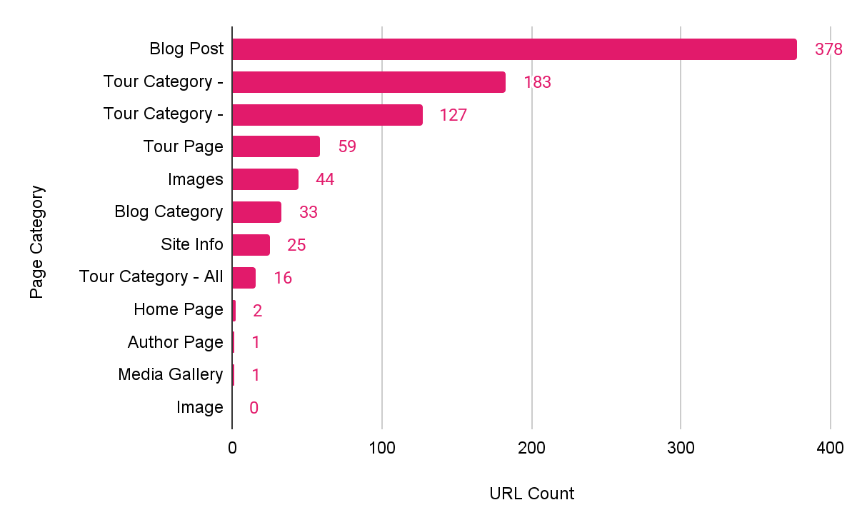
Site Structure Overview
Notes:
Link to Chart: https://docs.google.com/spreadsheets/d/1iVwRSLuiEbiB7qZ2mO2fu30A41cHCz05LZ4_o6Cs1mk/edit?gid=1618588231#gid=1618588231

Slide 8
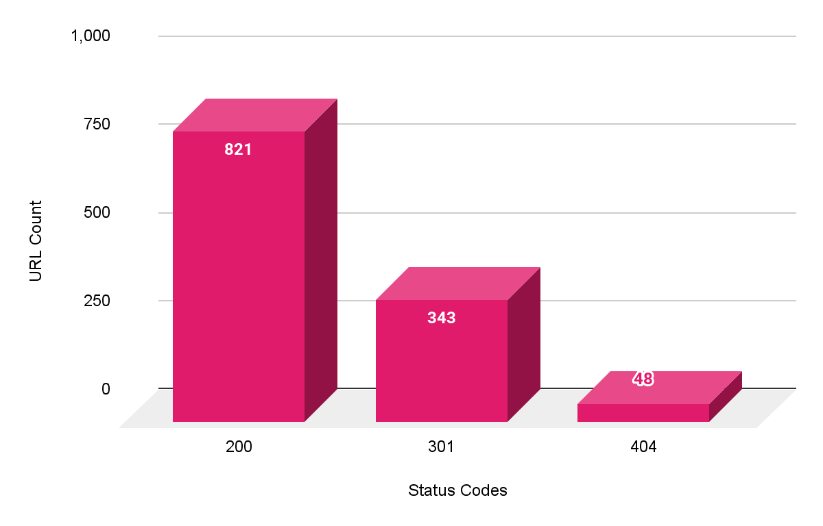
Site Structure Overview
Status Codes Heading
Notes:
Link to Chart: https://docs.google.com/spreadsheets/d/1iVwRSLuiEbiB7qZ2mO2fu30A41cHCz05LZ4_o6Cs1mk/edit?gid=1975750220#gid=1975750220

Slide 9
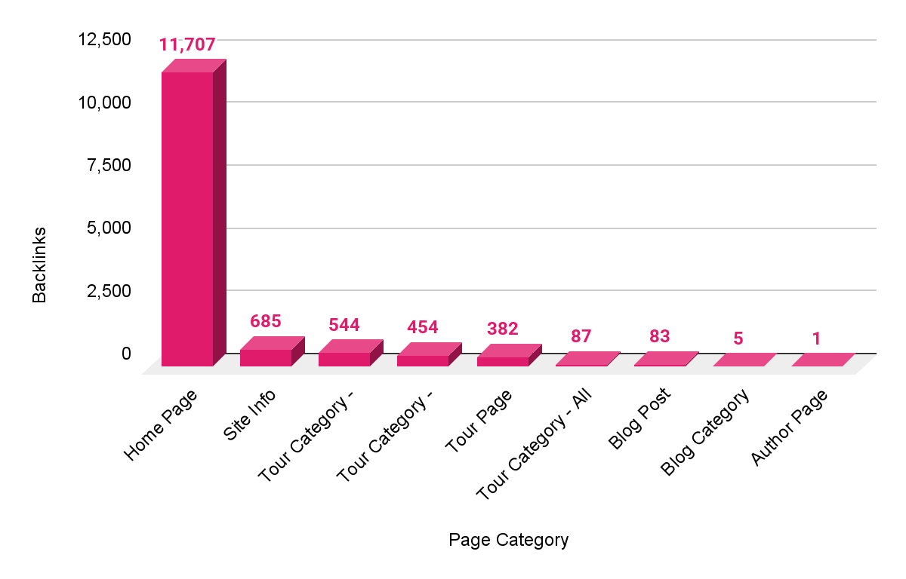
Site Authority Overview
Backlinks by Category
Notes:
Link to Chart: https://docs.google.com/spreadsheets/d/1iVwRSLuiEbiB7qZ2mO2fu30A41cHCz05LZ4_o6Cs1mk/edit?gid=1307378891#gid=1307378891

Slide 10
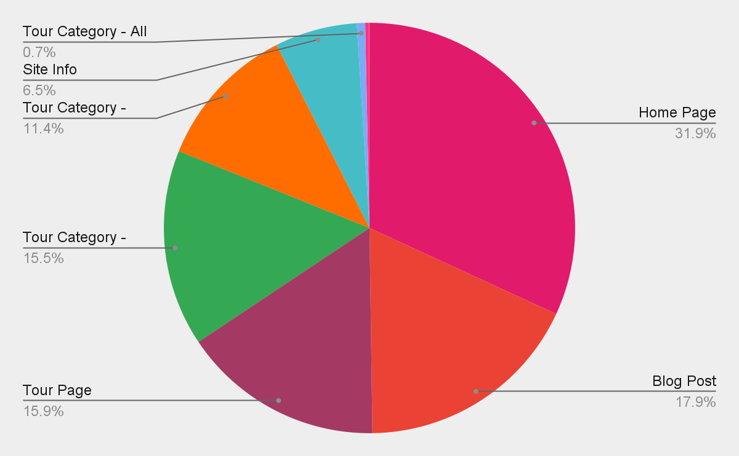
Organic Performance - Traffic
Sessions by Category
Notes:
Link to Chart: https://docs.google.com/spreadsheets/d/1iVwRSLuiEbiB7qZ2mO2fu30A41cHCz05LZ4_o6Cs1mk/edit?gid=92554350#gid=92554350

Slide 11
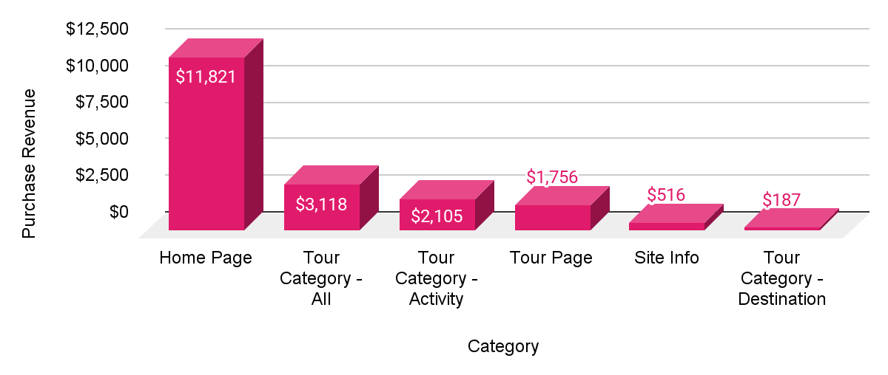
Organic Performance - Bookings
Revenue
Top 5 Pages by Revenue | Purchase Revenue
https://www.coloradorafting.net/ | $11,821
https://www.coloradorafting.net/trip-packages/ | $3,118
https://www.coloradorafting.net/trip-packages/raft-via-ferrata/ | $1,145
https://www.coloradorafting.net/trip-packages/raft-utv-rentals/ | $795
https://www.coloradorafting.net/trips/clear-creek-gold-rush/ | $718
Notes:
Link to Revenue by Category Bar Chart: https://docs.google.com/spreadsheets/d/1iVwRSLuiEbiB7qZ2mO2fu30A41cHCz05LZ4_o6Cs1mk/edit?gid=1065132173#gid=1065132173
Link to Top 5 Pages by Revenue Table: https://docs.google.com/spreadsheets/d/1iVwRSLuiEbiB7qZ2mO2fu30A41cHCz05LZ4_o6Cs1mk/edit?gid=1611787336#gid=1611787336

Slide 12
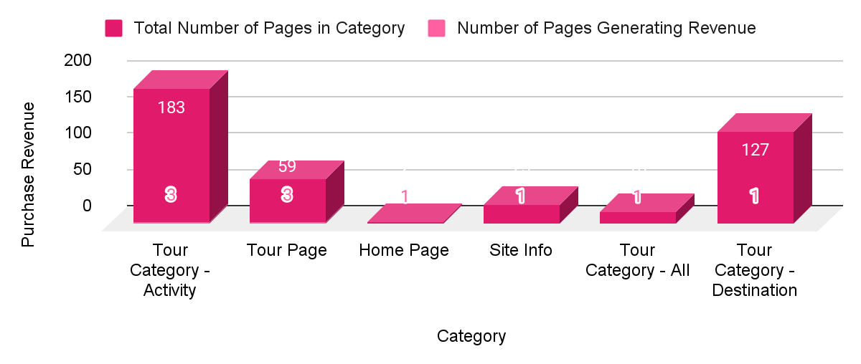
Organic Performance - Bookings
Pages Driving Revenue
Notes:
Link to # of Pages Driving Revenue by Category Bar Chart: https://docs.google.com/spreadsheets/d/1iVwRSLuiEbiB7qZ2mO2fu30A41cHCz05LZ4_o6Cs1mk/edit?gid=1428278599#gid=1428278599

Slide 13

What are your outcomes?
Issue: Improper Canonicalization of Paginated Blog URLs
Current Setup: All paginated blog and trip category URLs (e.g., /blog/?sf_paged=2, /blog/?sf_paged=3, etc.) canonicalize to the main blog or trip category page.
Why This is a Problem:
Indexation Loss: Search engines may not index deeper blog posts that only appear on paginated URLs, reducing their discoverability.
Diluted Signals: Links, crawl signals, and engagement metrics from paginated pages are not attributed correctly, which can hurt overall blog performance.
Bad for SEO: Canonicalizing all paginated URLs to /blog/ contradicts Google's pagination best practices, even post-rel=next/prev deprecation.
Recommendation: Canonicalize - Use Self-Referencing Canonical Tags
Each paginated page should canonicalize to itself:
/blog/?sf_paged=2 → canonical to /blog/?sf_paged=2
/blog/?sf_paged=3 → canonical to /blog/?sf_paged=3
This will fix all issues in the “Aggregation” tab assigned a “Canonicalize” URL Action.

Slide 14
What are your outcomes?
Issue: Internal Links Point to 301 Redirects
Over 300 internal links on the site point to URLs that return a 301 redirect instead of linking directly to the final destination page.
Why This is a Problem:
Wasted Crawl Budget: Search engines must crawl both the redirect and the destination, reducing efficiency.
Diluted Link Equity: Although Google passes PageRank through redirects, some value may be lost or delayed.
Slower Page Load: Each redirect adds extra HTTP requests, which can negatively affect page speed and user experience.
Signals Confusion: It creates unnecessary complexity for search engines trying to interpret your internal structure.
Recommendation: Update all internal links to point directly to the final URL
Using the “Find and Remove or Replace” tab in the WQA, perform a Find and Replace for all 301 Redirects on the site, as instructed by the sheet.
This will fix all issues in the “Aggregation” tab assigned a “Find and Replace” URL Action.

Slide 15
What are your outcomes?
Opportunity: Improve EEAT (Experience, Expertise, Authoritativeness, Trustworthiness) Signals
Recommendation #1: Create Individual Author Pages
A single "Meet Our Authors" page lists contributors but does not include dedicated author profile pages.
Create an individual page for Amber and Mitchell, including:
Author photo and bio
Relevant credentials or experience
Links to all articles written by the author
Links to their social or professional profiles
Recommendation #2: Set Privacy Policy Page to Index/Follow Pages like Privacy Policy, Terms of Service, and Accessibility statements help demonstrate your site’s credibility and legitimacy — especially important for Google’s quality signals.
Recommended Fix: Follow the URL Action assigned to https://www.coloradorafting.net/privacy-policy/ and set the page meta tags to Index, Follow

Slide 16
What are your outcomes?
Opportunity: Remove /booknow/ Page
The /booknow/ page is duplicative of other pages like /adventures/ and /adventures/all-trips/, and does not provide a direct booking function. It also occupies a spot in the main navigation menu.
Why This Is a Problem
Redundant Content: The /booknow/ page repeats information available on other pages, offering no unique value to users.
User Experience Confusion: Despite its title, the page lacks a direct booking interface, potentially misleading users expecting to book an experience immediately.
Navigation Clutter: Including a non-functional booking page in the main menu can detract from the site's usability and clarity.
Recommended Fix: Delete the /booknow/ page and remove the page from the menu to eliminate redundancy and potential user confusion.

Slide 17

THANK YOU!
www.propellic.com

